Slide 1
V2.5.0
New Features and Process

Slide 2
Reports
In V2.5.0 we have added in two more requested reports:
Sales By Date
Payment By Date

Slide 3
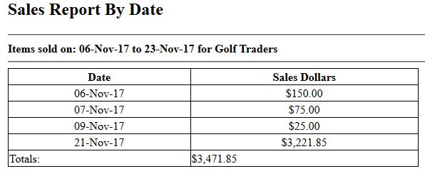
Sales By Date
This report is broken down into two sections:
Date
Sales Dollars
In the second column there is a sum of the sales dollars made on the corresponding date

Slide 4
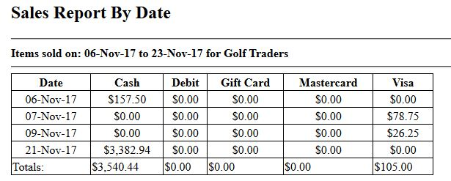
Payments By Date
This reports displays the days earnings for each of the methods of payment. Then displays a total of each method

Slide 5
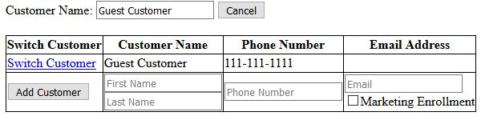
Email Address Display During Sale
Switching customers during a sale now displays their email address
When adding a customer during a sale, you now have the option to add an email address and enroll them in marketing

Slide 6
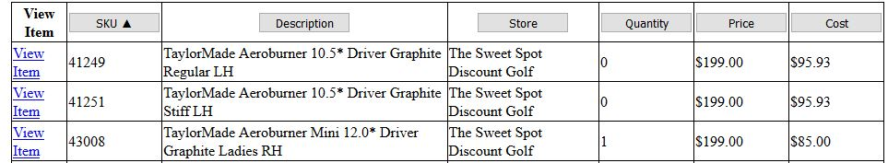
Inventory Sorting
When searching for inventory in the Inventory homepage, you can now click on the buttons that appear at the top of the search to display them in either ascending or descending order

Slide 7
Bug Fixes
Error: When starting new sale there are items already added into cart and the user cannot cancel the sale or remove the items from cart
Currently the only fix when this happens is to shut down the browser and re-open it
We believe that we have created a work around for the error so that it can’t happen anymore
If it does please report asap
Try to remember as much information about the previous sale as possible

Slide 8
Minor Updates/Changes
Inventory paging limit increased to 50
Previously set at 25
Default inventory order set to descending order by SKU number

